Slide 1
Lecture 23

Slide 2
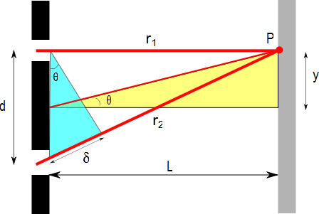
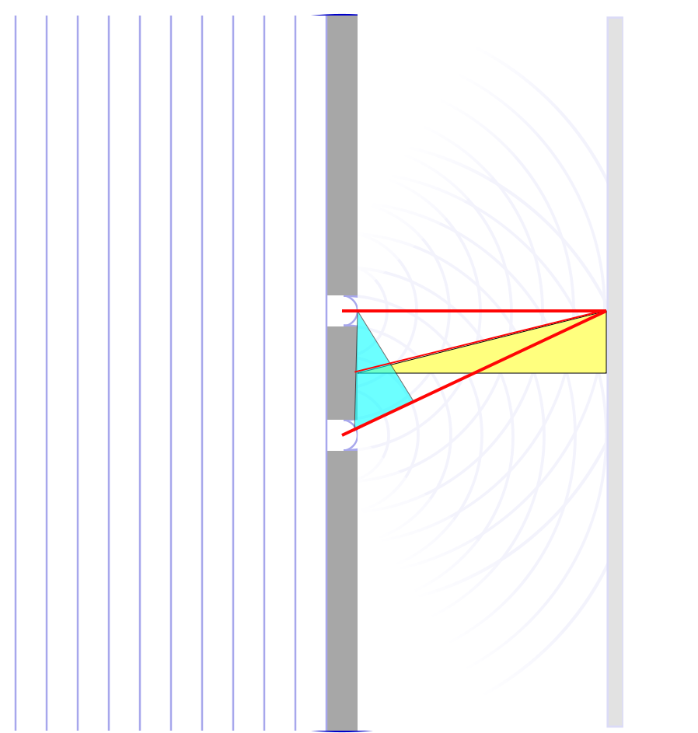

$$∆r$$

Slide 3
ConcepTest 24.3a Double Slits I
In a double-slit experiment, when the wavelength of the light is increased, the interference pattern
spreads out
stays the same
shrinks together
disappears

Slide 4
ConcepTest 24.3a Double Slits I
In a double-slit experiment, when the wavelength of the light is increased, the interference pattern
spreads out
stays the same
shrinks together
disappears
d sin θ = m λ
If λ is increased and d does not change, then θ must increase, so the pattern spreads out.

Slide 5
ConcepTest 24.3b Double Slits II
If instead the slits are moved farther apart (without changing the wavelength) the interference pattern
spreads out
stays the same
shrinks together
disappears

Slide 6
ConcepTest 24.3b Double Slits II
If instead the slits are moved farther apart (without changing the wavelength) the interference pattern
spreads out
stays the same
shrinks together
disappears
d sin θ = m λ
If instead d is increased and λ does not change, then θ must decrease, so the pattern shrinks together
Follow-up: When would the interference pattern disappear?

Slide 7
$$∆r$$

Slide 11
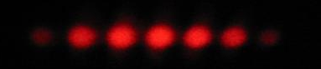
I
Interference fringes:
due to having two slits.
φ/2
-5π
-3π
-π
π
3π
5π

Slide 13
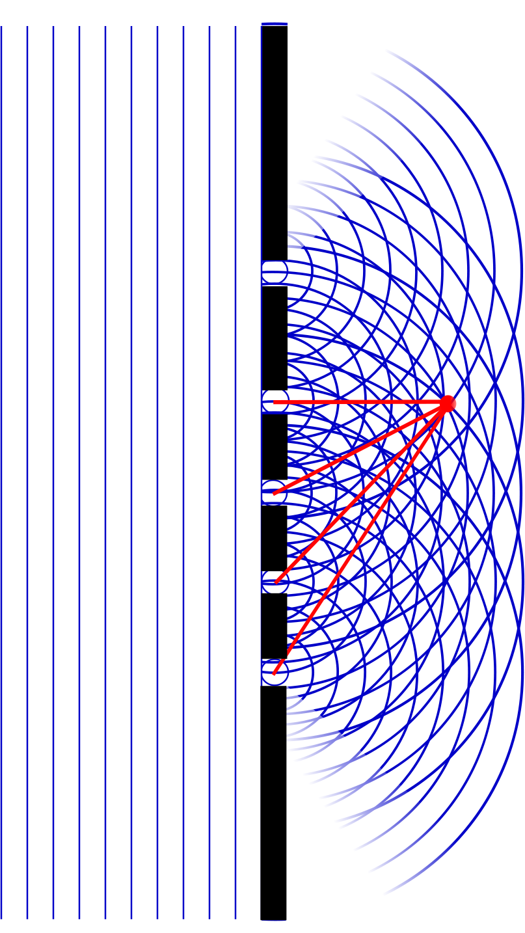
Question
At point A, there will be
Constructive interference
Destructive interference
Partial constructive interference
Partial destructive interference
A

Slide 15
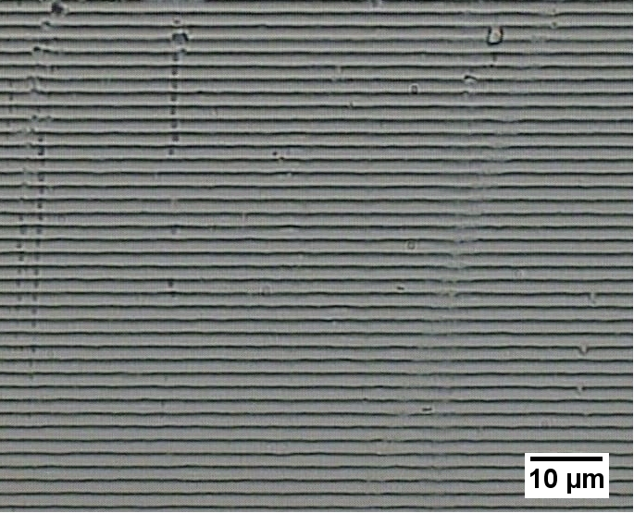

Slide 16
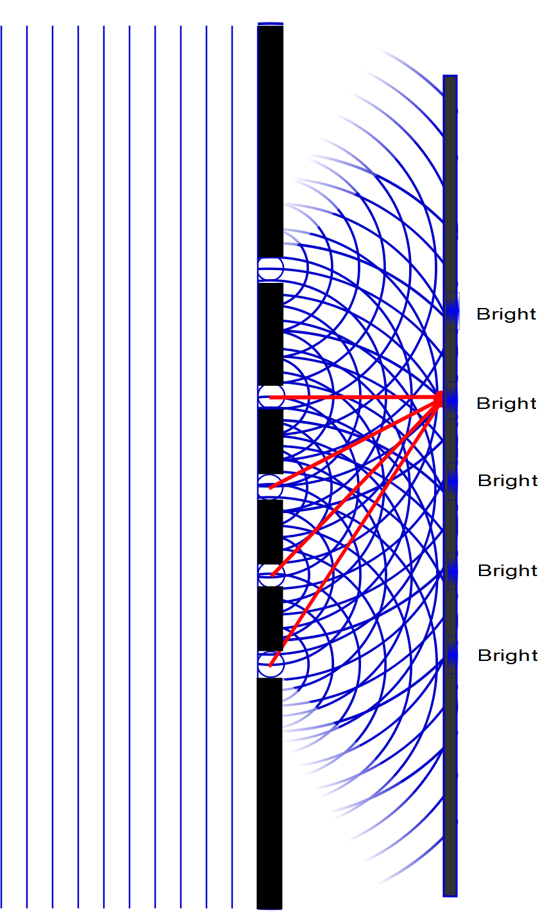

Slide 17
Question
Which will be a brighter spot, pint A or point B?
A
B
They will be the same
A
B

Slide 18
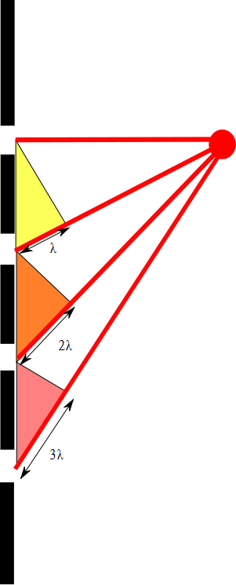

Slide 19
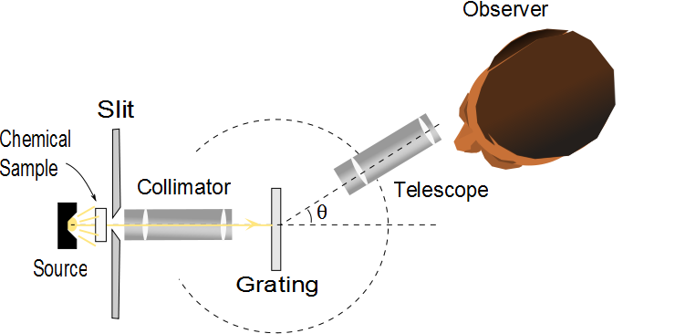
Diffraction Grating Spectrometer
The collimated beam is incident on the grating
The diffracted light leaves the gratings and the telescope is used to view the image
The wavelength can be determined by measuring the precise angles at which the images of the slit appear for the various orders

Slide 20
Details

Slide 21
Diffraction Grating, Intensity, cont.
Characteristics of the intensity pattern
The sharp peaks are in contrast to the broad, bright fringes characteristic of the two-slit interference pattern
Because the principle maxima are so sharp, they are much brighter than two-slit interference patterns

Slide 22
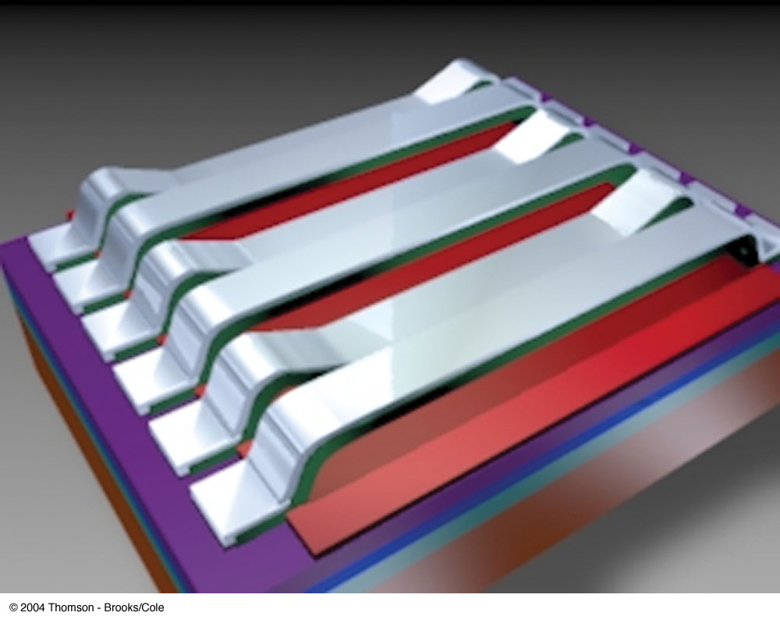
Grating Light Valve
A grating light valve consists of a silicon microchip fitted with an array of parallel silicon nitride ribbons coated with a thin layer of aluminum
When a voltage is applied between a ribbon and the electrode on the silicon substrate, an electric force pulls the ribbon down
The array of ribbons acts as a diffraction grating

Slide 23
Resolving Power of a Diffraction Grating
For two nearly equal wavelengths, λ₁ and λ₂, between which a diffraction grating can just barely distinguish, the resolving power, R, of the grating is defined as
Therefore, a grating with a high resolution can distinguish between small differences in wavelength

Slide 24
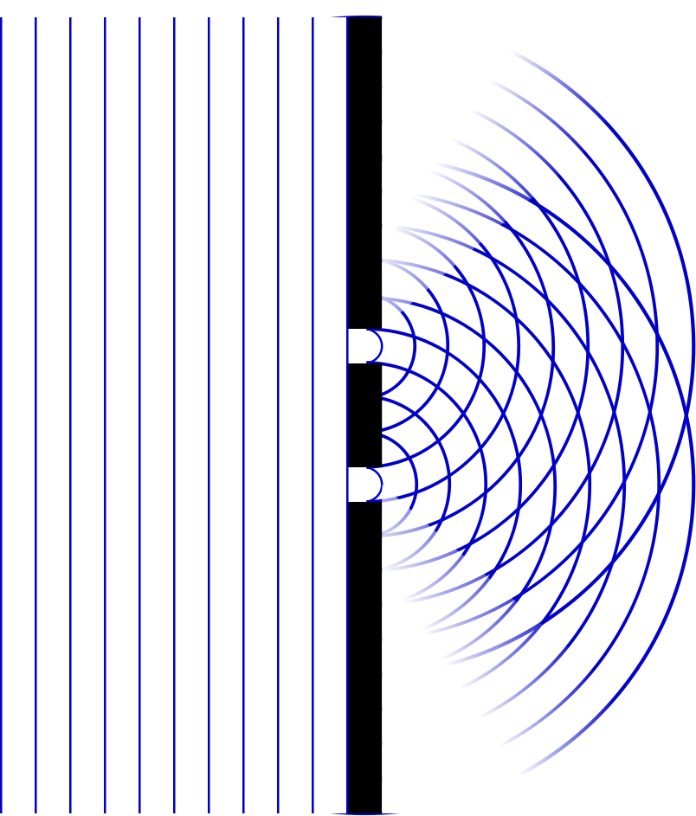
Question
Which will be a narrower, pint A or point B?
A
B
They will be the same
A
B

Slide 25
Single Slit Envelope
2 slits
Intensity pattern
3 slits
4 slits
5 slits
10 slits
100 slits

Slide 26

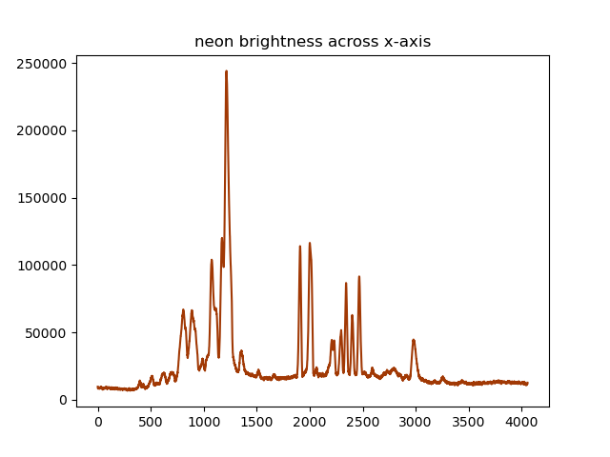
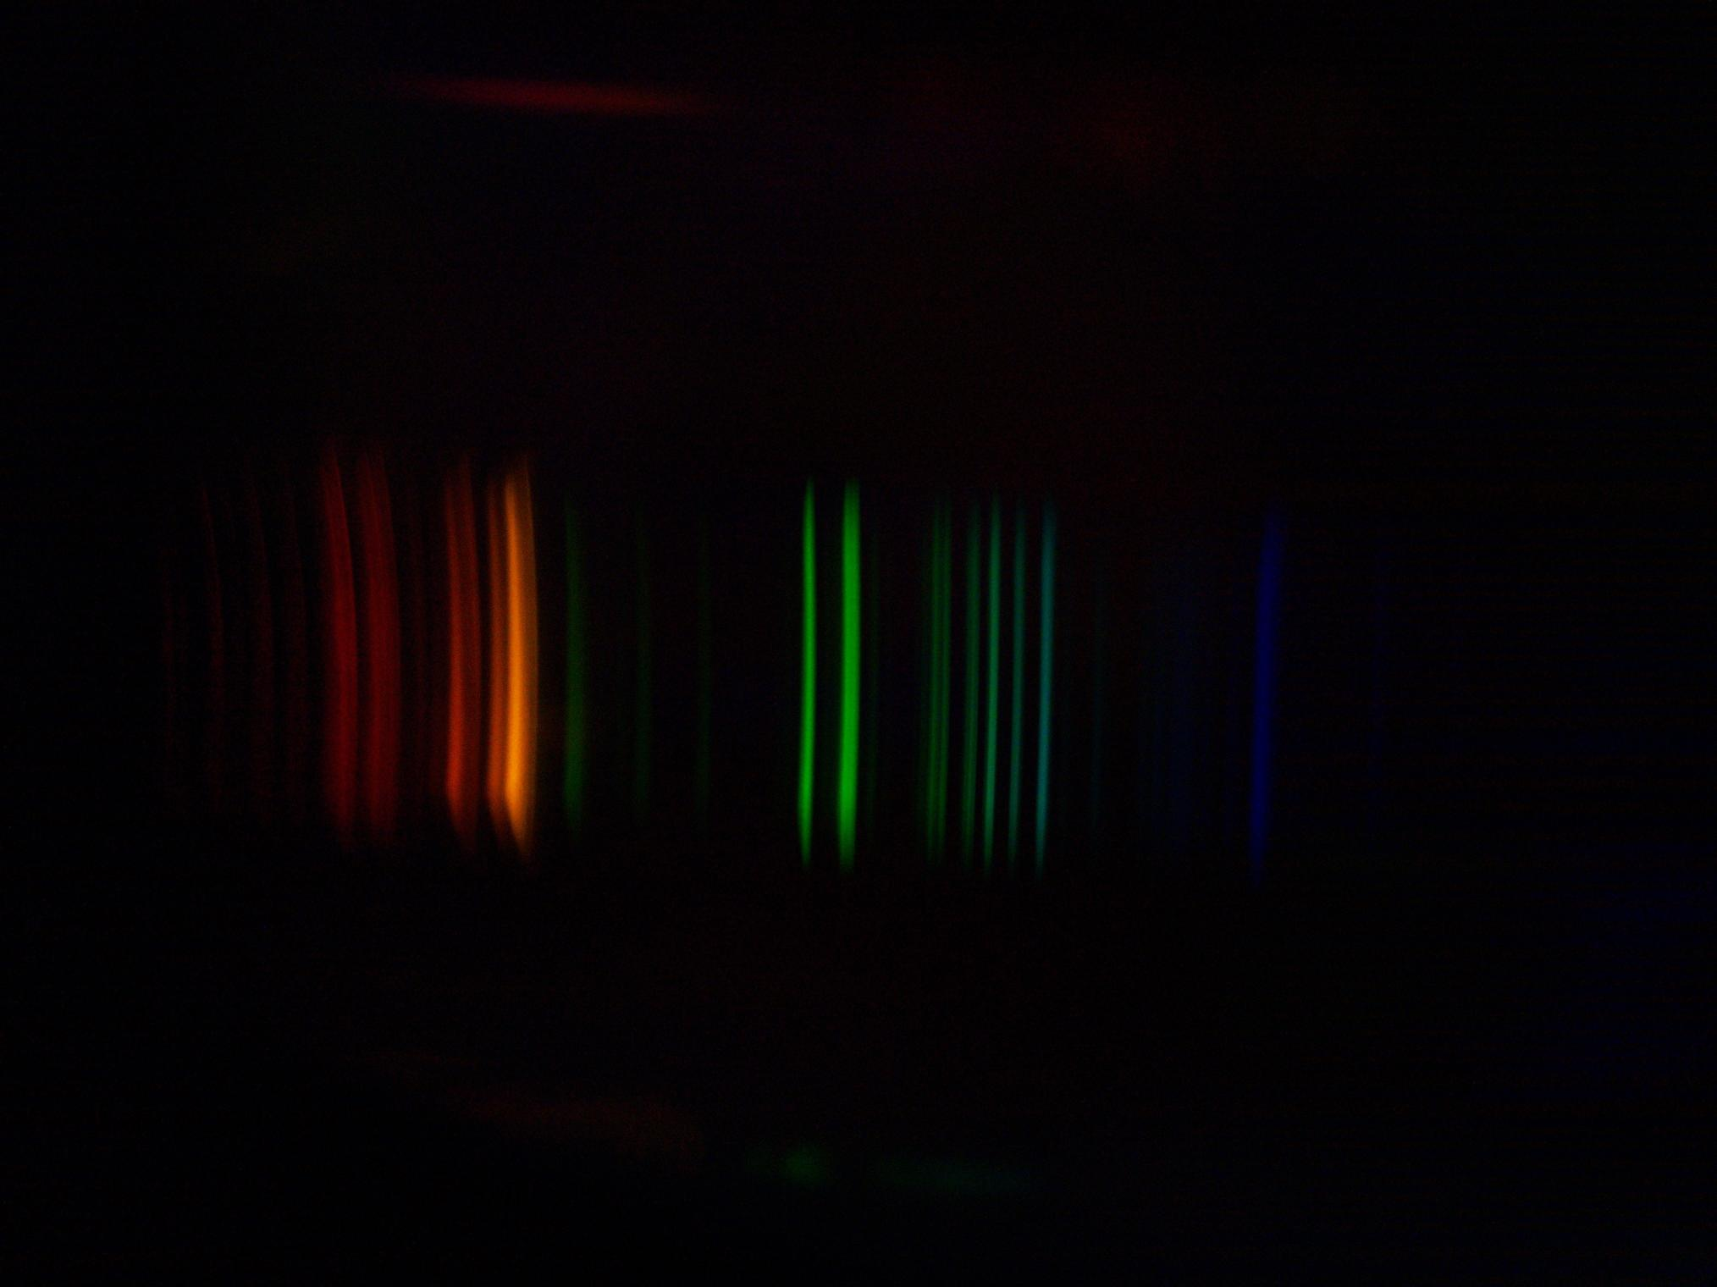
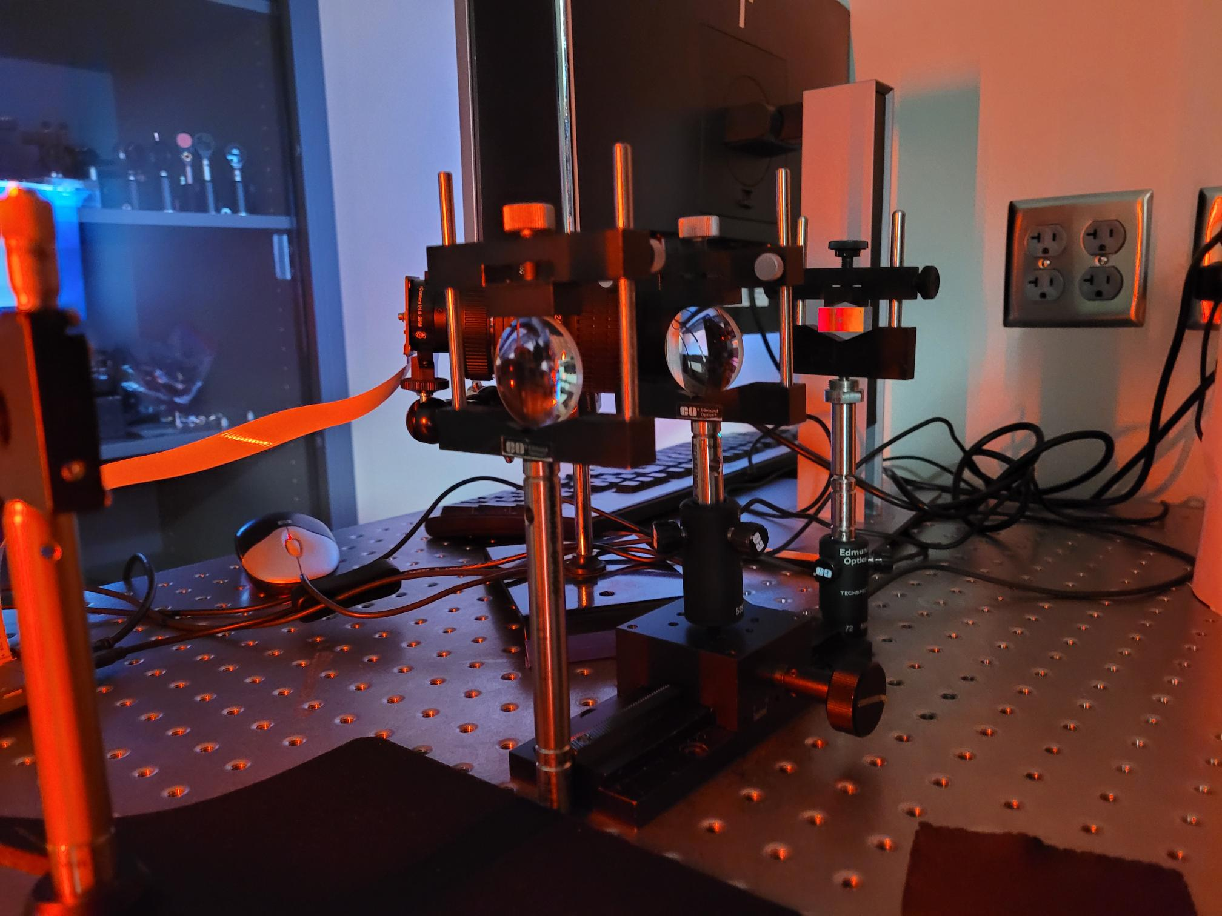

Slide 27
Resolving Power of a Diffraction Grating, cont
The resolving power in the mth-order diffraction is R = Nm
N is the number of slits
m is the order number
Resolving power increases with increasing order number and with increasing number of illuminated slits

Slide 28
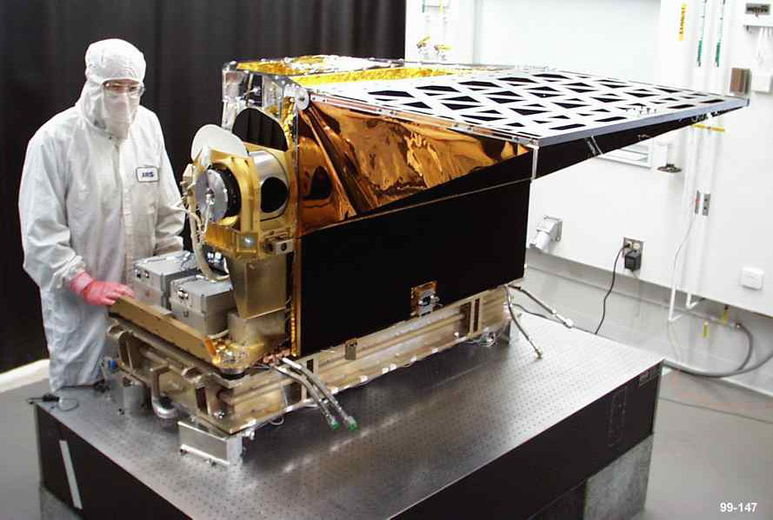
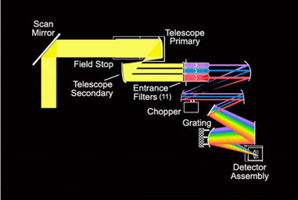


AIRS

Slide 29
END

